Slide 1
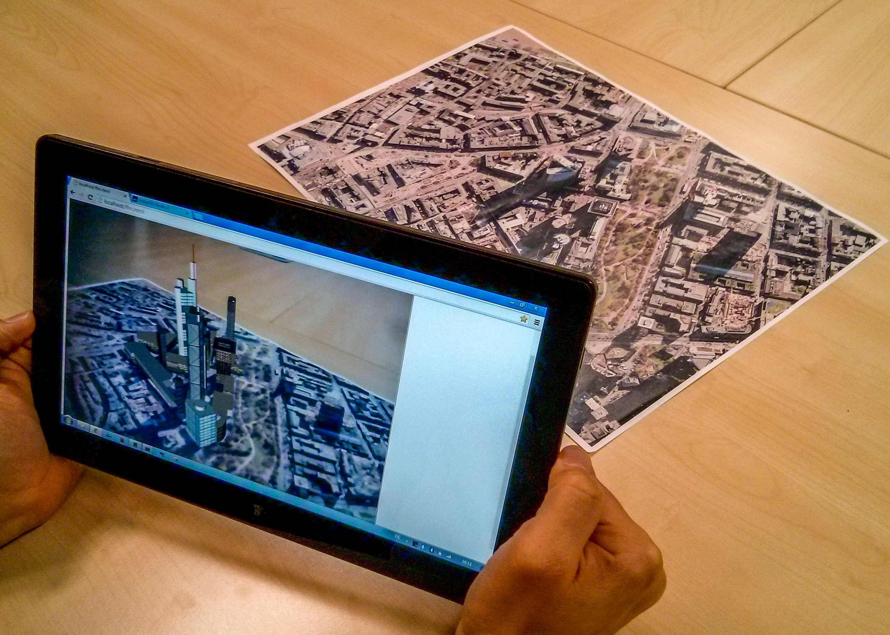
Remote Visual Tracking
for the (Mobile) Web
a presentation by Jonas Kleinkauf

Slide 2
presentation content
paper summary
app idea – Googly Eyes Cam
system architecture
implementation details
live demo
final thoughts

Slide 3
paper summary
Research by Fraunhofer IGD and TU Darmstadt
Idea: Using constant data streams to outsource computer vision for AR applications to a server instead of the mobile device
Implemented with X3DOM, Fraunhofer InstantIO and Fraunhofer InstantVision (latter one is proprietary by now)
Application: Bringing a photo of a city map to life with 3D buildings in the web

Slide 4
paper summary

Slide 5
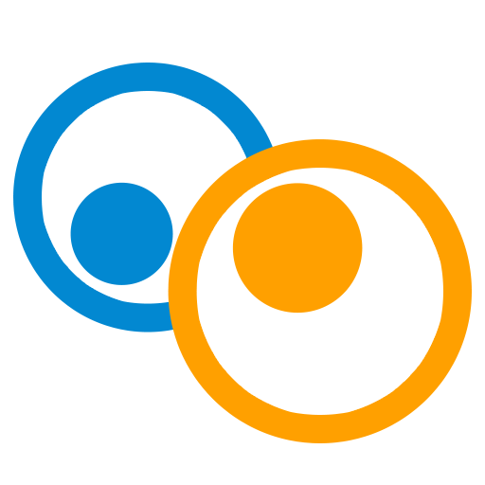
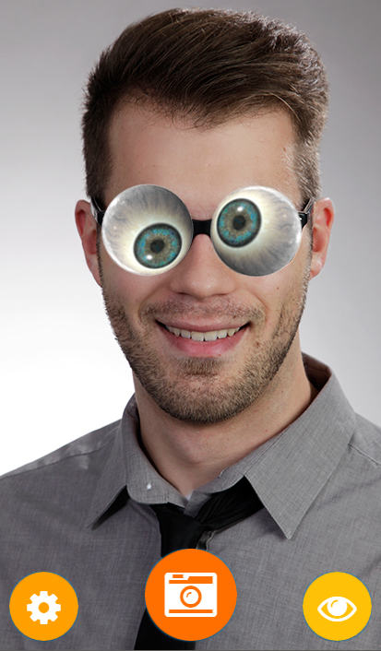
app idea – Googly Eyes Cam
Notes:
one codebase: main selling point. BUT: There is also xamarin, unity… POINT2: Learning curve really good, and support/community quite nice
DEBUGGER for example in chrome?

Slide 6

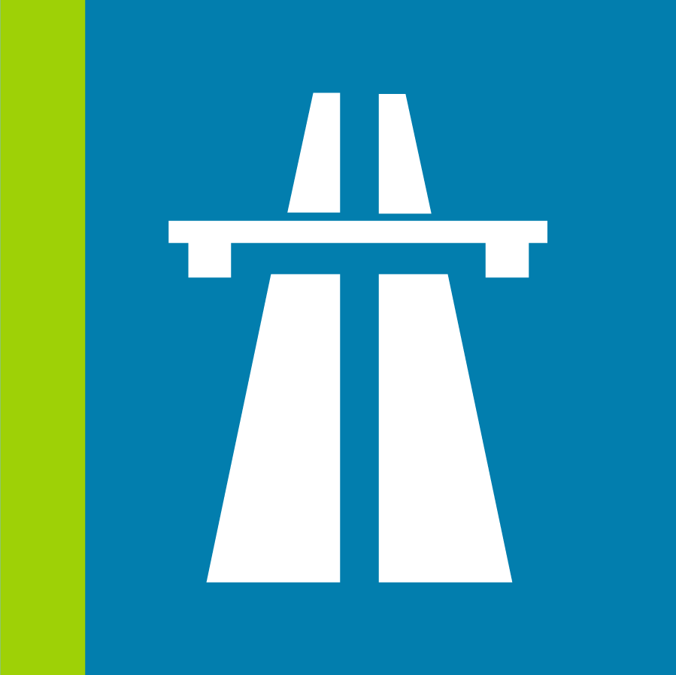
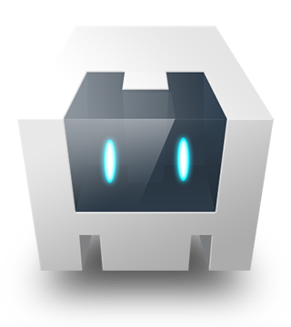
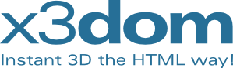
planned system architecture
OpenCV (Python)
autobahnWS
x3dom
Apache Cordova
Notes:
terms are basically interchangable
PhoneGap original developed by Nitobi, sold to Adobe in 2011. Adobe then donated the core code to apache open source, but made additional proprietary services in build tools
source: http://phonegap.com/blog/2012/03/19/phonegap-cordova-and-whate28099s-in-a-name/
phonegap services are only partially free, cordova base is free overall
for easier understanding, i will only use the term cordova in the presentation, cause it is the core thing you need

Slide 7
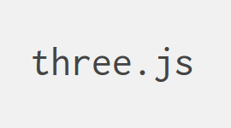
actual system architecture
MaterializeCSS
local
tracking.js
three.js
Apache Cordova
remote
OpenCV (Python)
autobahnWS
Notes:
terms are basically interchangable
PhoneGap original developed by Nitobi, sold to Adobe in 2011. Adobe then donated the core code to apache open source, but made additional proprietary services in build tools
source: http://phonegap.com/blog/2012/03/19/phonegap-cordova-and-whate28099s-in-a-name/
phonegap services are only partially free, cordova base is free overall
for easier understanding, i will only use the term cordova in the presentation, cause it is the core thing you need

Slide 8
live demo

Slide 9
final thoughs
Remote Server around 3-4 times faster than local tracking (Could be influenced by the quality of the CV libraries though)
Live camera handling with cordova not as easy as thought (at least for Android)
Rapid Prototyping with Cordova definitly given, easy UI implementation
Cross-Platform Capabilites not tested, but very likely possible with little efford (used Cordova plugins available for iOS aswell)

Slide 10
thank you! Questions?

